Slide 1
GETTING THE
RIGHT
JOB
CHAPTER 9
THE SEARCH PARAMETERS
Outcomes: “I will develop an understanding of the factors that will drive my
search, including location, function, and industry or sector.
Notes:
As with any “Chapter 1” you should always start with the Basics. In anticipation of getting the right job, you must make certain commitments to your purpose. You’ll find that understanding “who you are” will be essential to a successful outcome. Say to yourself: “I will be open to learning more about myself and embracing my strengths and challenges.” And, start today to believe it.

Slide 2
DEFINING THE SEARCH
There are three key factors that guide both the internship and job search processes: location, job function, and industry.
For most people, one of these factors is much more important that the other two, but for some all three are equally important. Only you can make that determination for your search, and many factors contribute to the varied weights.

Slide 3
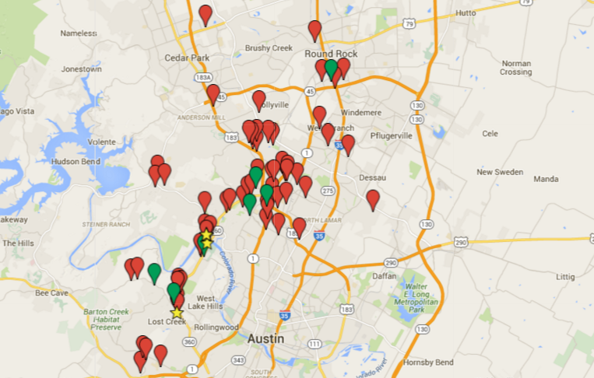
LOCATION - JOB FUNCTION - INDUSTRY
If you are single, LOCATION may currently not be a factor, but it might become a major factor once
you are married, cohabitating,
or have children.
JOB FUNCTION is often the main driver for those with skills-based degrees or experience, like nurses, engineers, teachers, or law enforcement officers.

Slide 4
LOCATION - JOB FUNCTION - INDUSTRY
Others may be more open regarding what they do, but know they want to be in a specific industry (tourism, healthcare, sports and athletics, manufacturing, etc.).
Often the INDUSTRY PREFERENCE is driven by what interests someone on a personal level, so be mindful of this as you work through the exercises in this chapter.

Slide 5
LOCATION - JOB FUNCTION - INDUSTRY
The following exercises are designed to guide you as you define and fine-tune your specific search parameters along with the associated weight of each one. Please seriously consider the questions asked, and take whatever time is necessary to provide your answers, as they will guide the rest of the search process.

Slide 6
LOCATION
EXERCISE 1
LOCATION: Do you have geographical limitations, or are you free to move anywhere for the right opportunity?
◻ I am free to move anywhere ◻ I have geographical limitations
If you indicated you have limitations, please complete the following:
I need to be within___ miles of this location: ________________________

Slide 7
LOCATION
OR... I would prefer to, or need to, live in one of the following cities:
1) ____________________________________________________________
2) ____________________________________________________________
3) ____________________________________________________________
OR... I would prefer to, or need to, live in the following regions/country/province: ________________________________________

Slide 8
JOB FUNCTION
EXERCISE 2
JOB FUNCTION: Based on the work you did earlier related to your Career Directions, what are the three to five job functions you will target? Prioritize them below with #1 being your top preference.
1.__________________________________
2.__________________________________
3. __________________________________
4. __________________________________
5.___________________________________
Butcher – Baker – Candle Stick Maker

Slide 9
INDUSTRY
EXERCISE 3
Based on all you have learned about yourself so far, what industry(ies) or business sector(s) are you most attracted to at this point (e.g., law enforcement, healthcare, K-12 education, tourism, media, agribusiness, entertainment, sports operations, business, etc.)?
List 5 in rank order.
1. __________________________________________________
2. ___________________________________________________
3. ___________________________________________________
4. ___________________________________________________
5. ___________________________________________________

Slide 10
LOCATION - JOB FUNCTION - INDUSTRY
Based on your answers in the previous exercises, you have all the information needed to record your search parameters in summary form.
This information will drive your research, your conversations, your networking, and your interviewing.

Slide 11
LOCATION - JOB FUNCTION - INDUSTRY
In the space below, record your answers creating a concise Parameters Summary. You will calculate the “Importance Value” requested once this portion of the exercise is complete.
JOB SEARCH PARAMETERS SUMMARY
My primary GEOGRAPHIC targets are:
(Importance)
My primary JOB FUNCTION targets are:
(Importance)
My INDUSTRY or business sector targets are:
(Importance)

Slide 12
do
the
MATH
Please assign a value to each of the three factors listed above. You may divide them 30/30/30 or another mix - but total 100. There is no wrong answer, but determining the right answer for you is critical.
My primary GEOGRAPHIC importance | ______
My primary JOB FUNCTION importance | ______
My INDUSTRY or business sector importance | ______
Now you have the parameters to begin your search. In the next chapter you will use this information to develop a marketing plan.

Slide 13
GETTING THE
RIGHT
JOB
BE INTENTIONAL
WORDS for your JOURNEY
• BE HONEST WITH YOURSELF ABOUT THE IMPORTANCE
OF LOCATION.
• KNOW WHAT YOU WANT, WHAT YOU NEED, AND LEARN
TO TELL THE DIFFERENCE.
• REMEMBER YOUR PRIORITIES.

